Slide 1
AZURE PROJECT
VAMSI KRISHNA ANNAVARAPU
MAIL ID:213474@ust-global.com

Slide 2
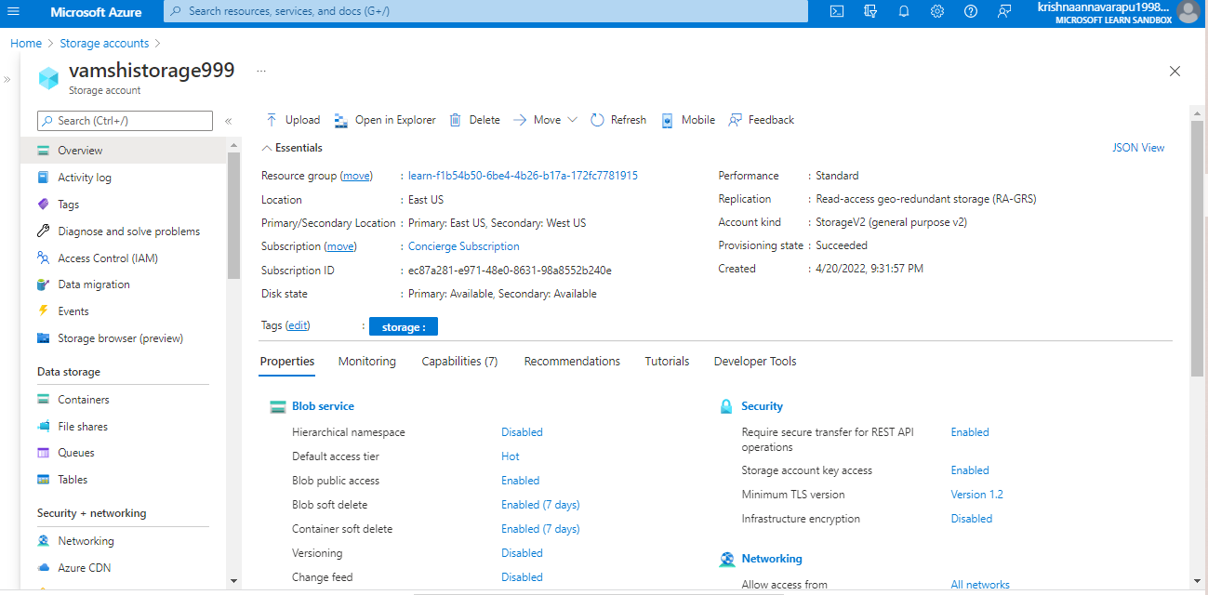
Storage account in Azure

Slide 3
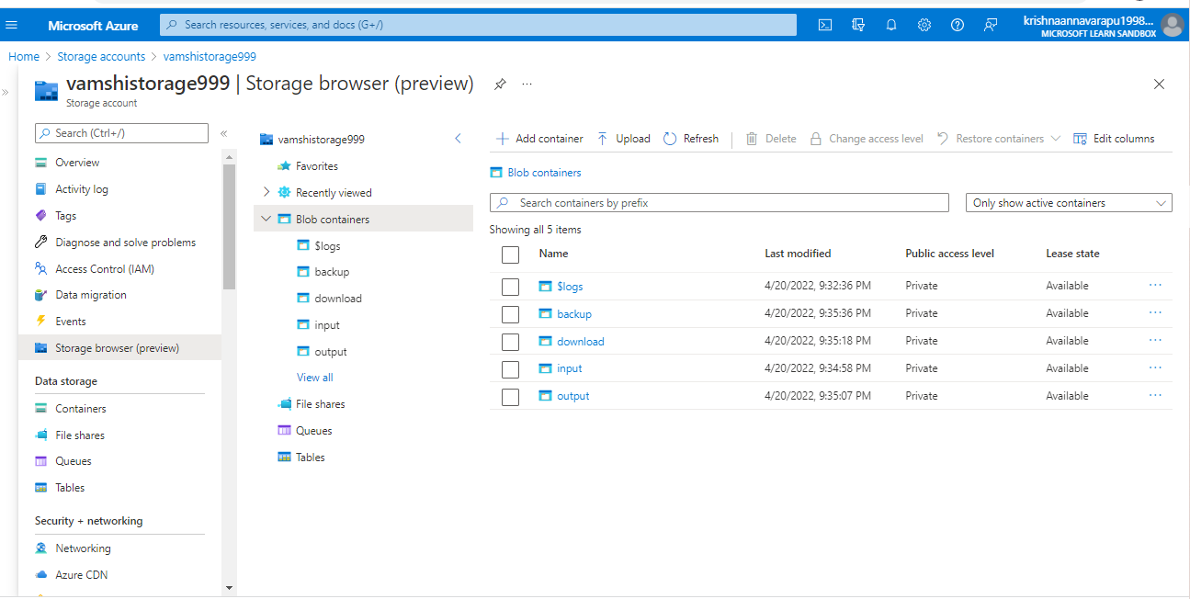
Four Containers

Slide 4
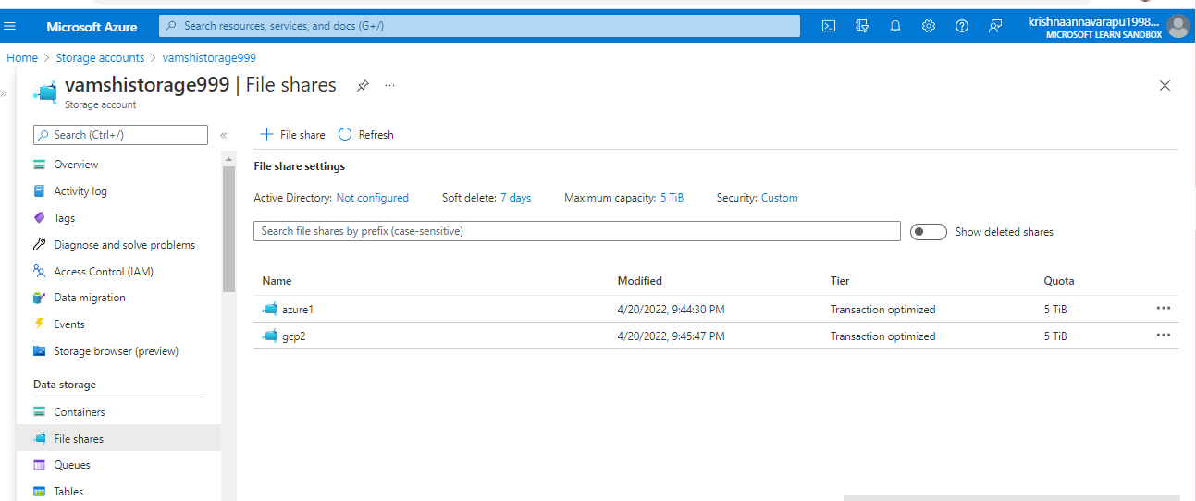
File Share with directory

Slide 5
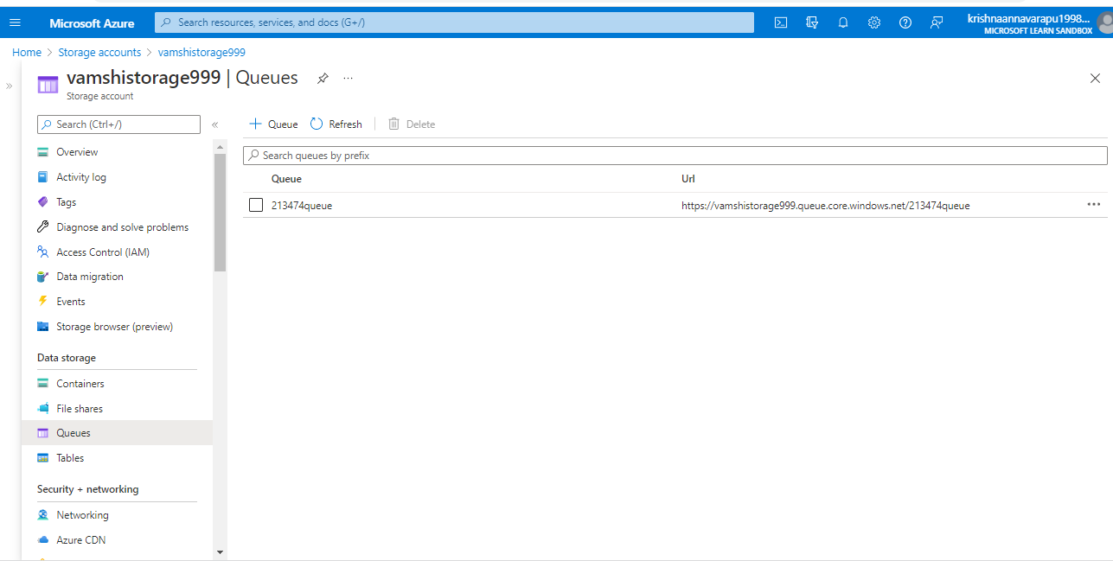
Queue

Slide 6
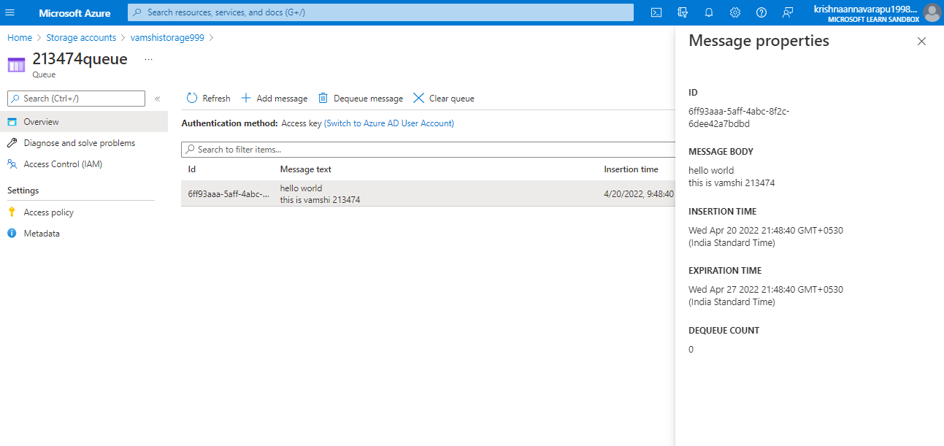
Message

Slide 7
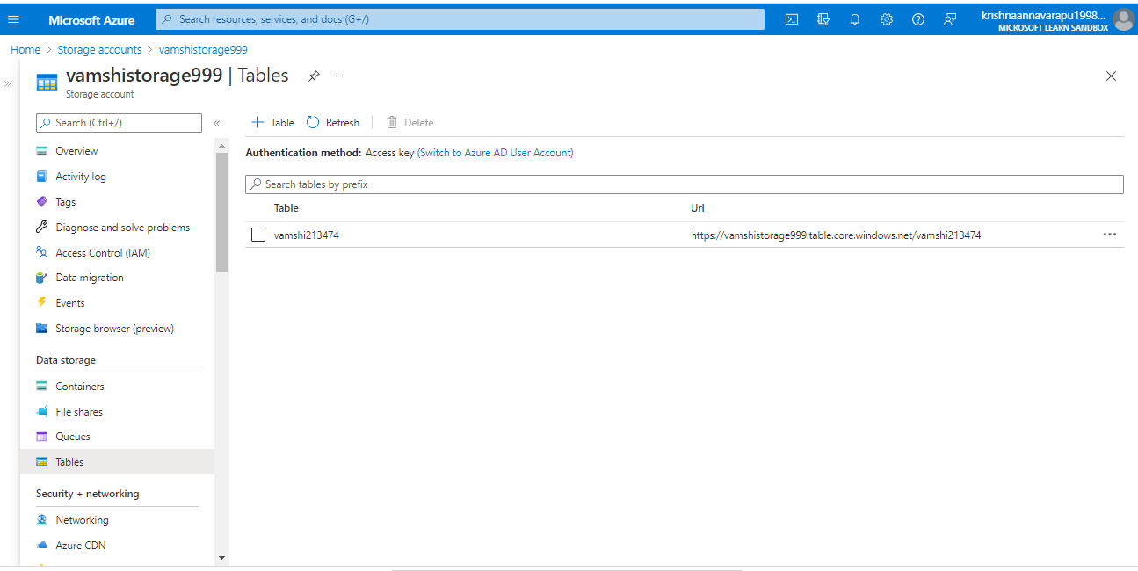
Table

Slide 8
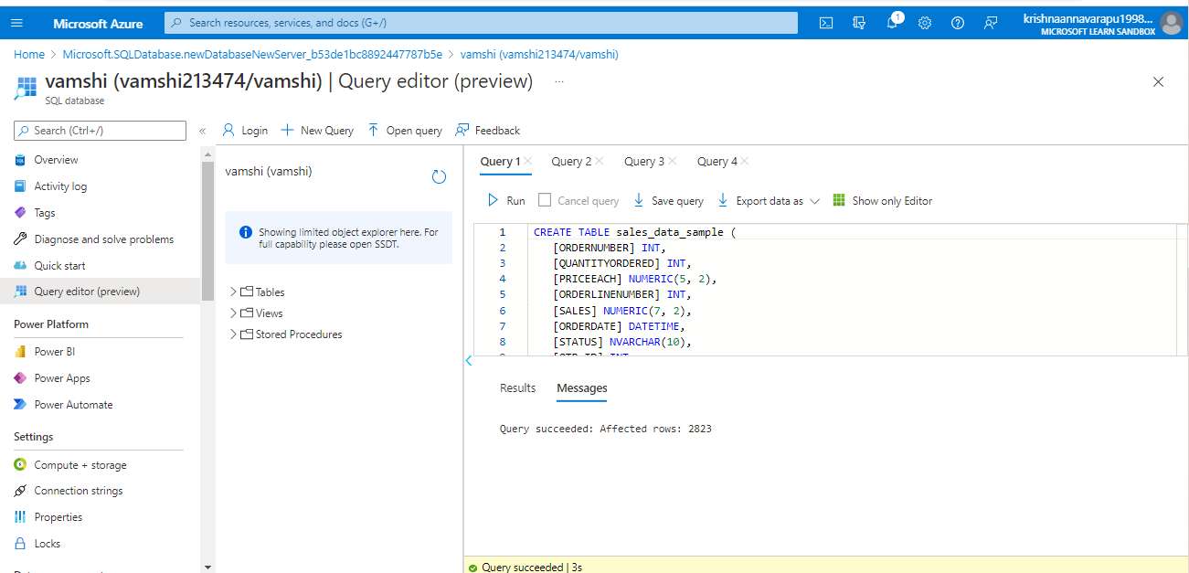
Database Query

Slide 9
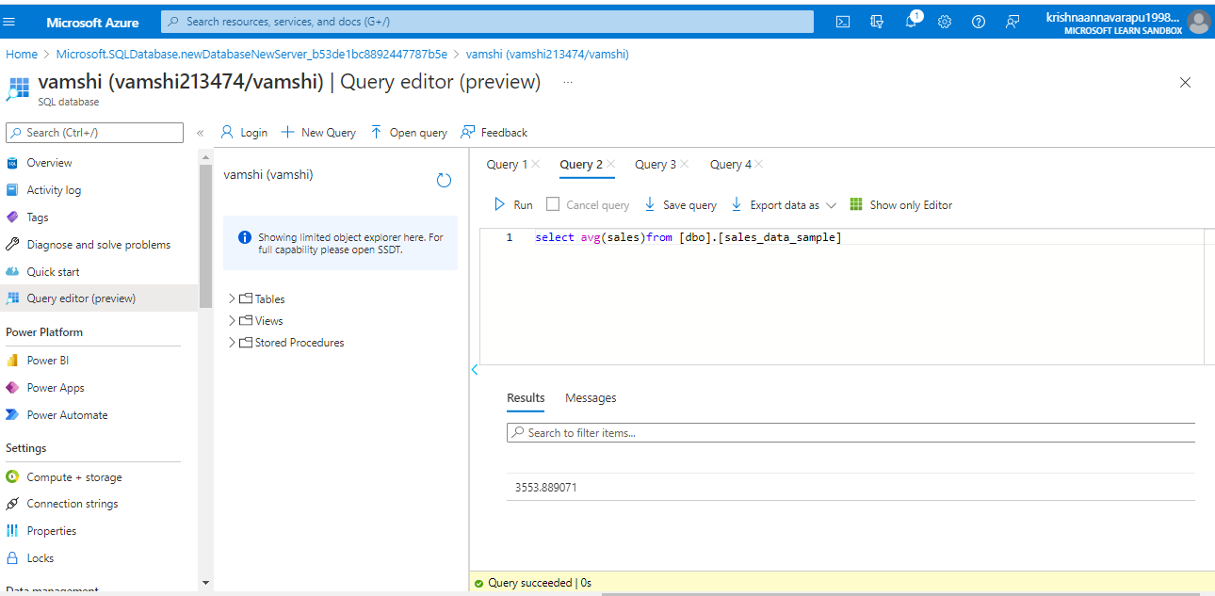
Sample database with Dimensions and Fact table.

Slide 10
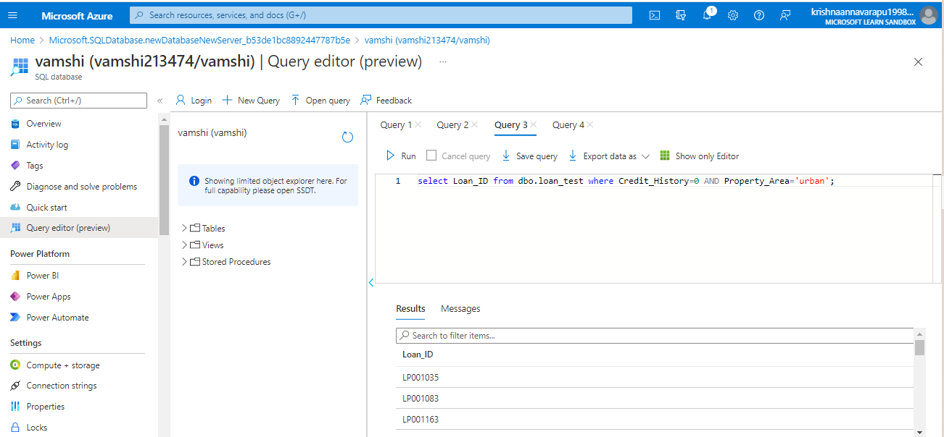
Financial need programs for consumer loan products.

